Slide 1


Slide 2
objectives
Derive phase from images projected with phase shifted sinusoids.
Unwrap phase image. (Optional: use quality-guided phase unwrapping algorithm.
Reconstruct 3D from phase difference of reference and object image phase.
1
2
3
Physics-301/Activity 05 - Basic Video Processing.ipynb at main · reneprincipejr/Physics-301 (github.com)
https://drive.google.com/file/d/1S1juRZtkc_vtyp8Ffvfp62fFIImtMSSb/view?usp=sharing

Slide 3
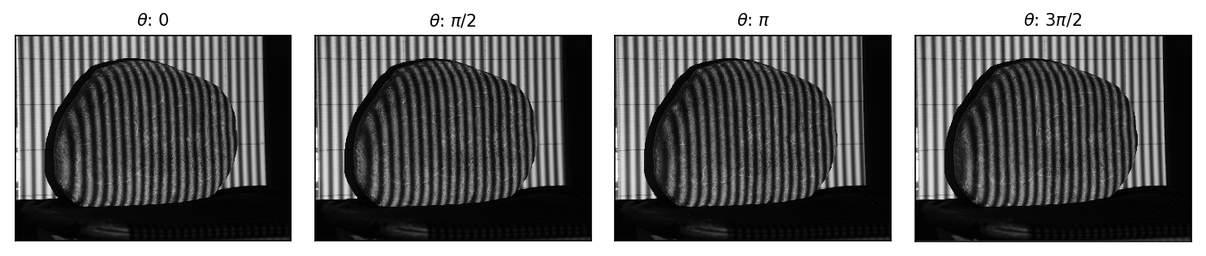
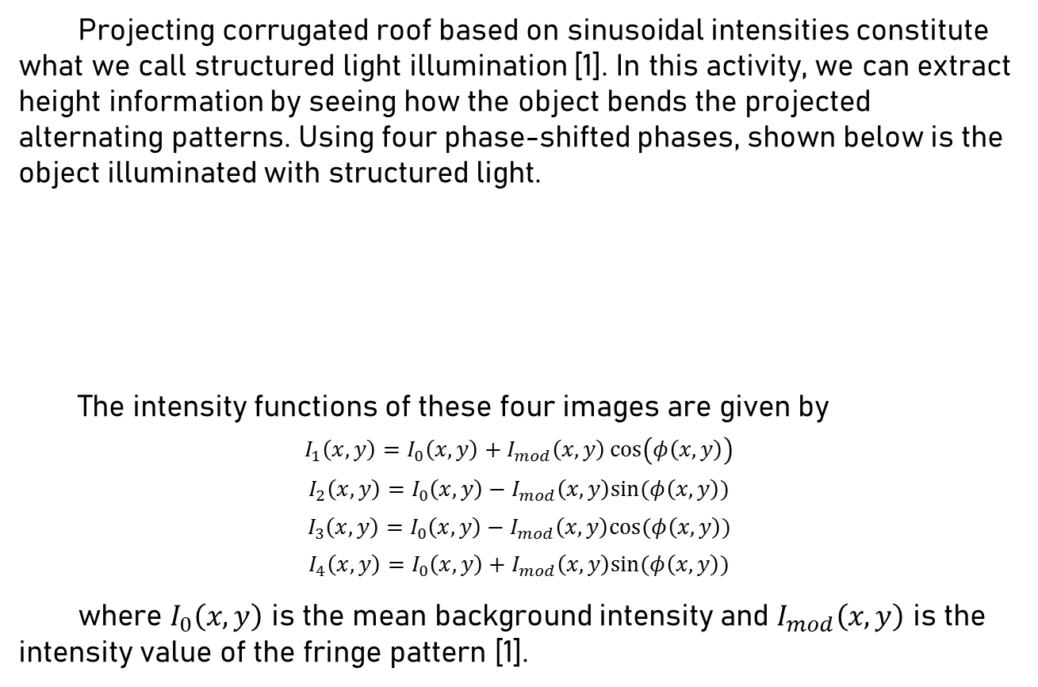
Structured Light
Projecting corrugated roof based on sinusoidal intensities constitute what we call structured light illumination [1]. In this activity, we can extract height information by seeing how the object bends the projected alternating patterns. Using four phase-shifted phases, shown below is the object illuminated with structured light.
The intensity functions of these four images are given by
$$I_{1}\left(x,y\right)=I_{0}\left(x,y\right)+I_{mod}\left(x,y\right)\cos\left(φ\left(x,y\right)\right)$$
$$I_{2}\left(x,y\right)=I_{0}\left(x,y\right)−I_{mod}\left(x,y\right)sin⁡(φ\left(x,y\right))$$
$$I_{3}\left(x,y\right)=I_{0}\left(x,y\right)−I_{mod}\left(x,y\right)cos⁡(φ\left(x,y\right))$$
$$I_{4}\left(x,y\right)=I_{0}\left(x,y\right)+I_{mod}\left(x,y\right)sin⁡(φ\left(x,y\right))$$
where $I_{0}\left(x,y\right)$ is the mean background intensity and $I_{mod}\left(x,y\right)$ is the intensity value of the fringe pattern [1].

Slide 4
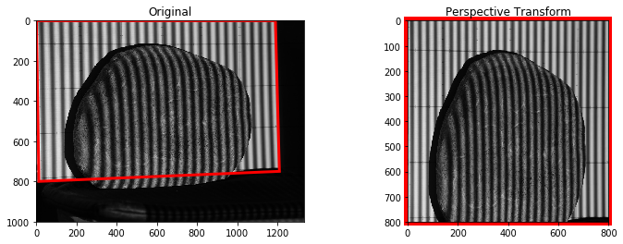
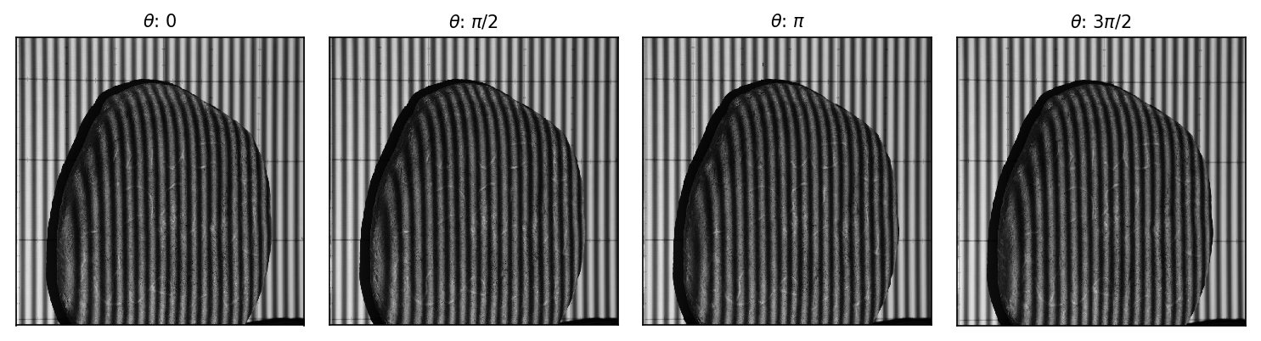
Perspective Transform
Before proceeding, it’s important to note that (1) the images are skewed in perspective and (2) we don’t have the images of flat reference. To address the first problem, we applied warp perspective functions from Open CV.
Shown below is the resulting perspective transformation which will now be used as our object images.

Slide 5
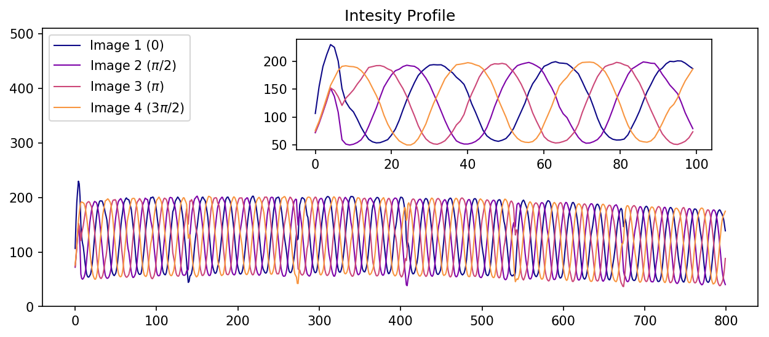
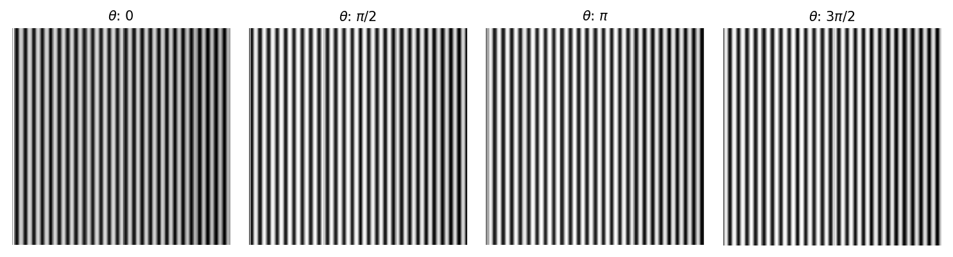
Flat reference
To address the next problem, we synthetically reconstruct the sinusoidal patterns from the region where the object doesn’t obstruct the view.
The average intensities will be the value set across all rows and there we reconstruct our flat reference image as shown below.0

Slide 6

Structured Light
$$I_{1}\left(x,y\right)=I_{0}\left(x,y\right)+I_{mod}\left(x,y\right)\cos\left(φ\left(x,y\right)\right)$$
$$I_{2}\left(x,y\right)=I_{0}\left(x,y\right)−I_{mod}\left(x,y\right)sin⁡(φ\left(x,y\right))$$
$$I_{3}\left(x,y\right)=I_{0}\left(x,y\right)−I_{mod}\left(x,y\right)cos⁡(φ\left(x,y\right))$$
$$I_{4}\left(x,y\right)=I_{0}\left(x,y\right)+I_{mod}\left(x,y\right)sin⁡(φ\left(x,y\right))$$

Slide 7
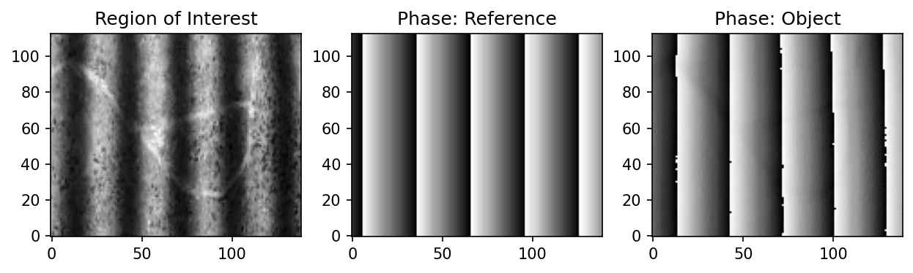

Structured Light
$$I_{4}\left(x,y\right)−I_{2}\left(x,y\right)={2I}_{mod}\left(x,y\right)sin⁡(φ\left(x,y\right))$$
$$I_{1}\left(x,y\right)−I_{3}\left(x,y\right)={2I}_{mod}\left(x,y\right)cos⁡(φ\left(x,y\right))$$
$$φ\left(x,y\right)=\tan^{−1}\left(\frac{I_{4}\left(x,y\right)−I_{2}\left(x,y\right)}{I_{1}\left(x,y\right)−I_{3}\left(x,y\right)}\right)$$

Slide 8
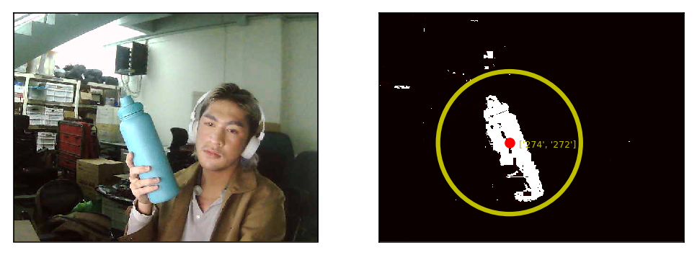
Blob detection
Non-parametric segmentation uses the histogram back-projection, a non-computational technique which treats histograms as look-up tables [2][3]. Recall that in Activity 1, the non-parametric method was generalized to be robust to intensity variation and can sometimes reveal extra details. We exploit this method’s advantage because in this activity, we’re dealing with scenes in very non-ideal conditions. Shown below is sample image segmentation of the cyan aquaflask as the object of interest. To track the object’s movement, we employed blob detection using the image moments to get the centroid coordinates [4].

Slide 9
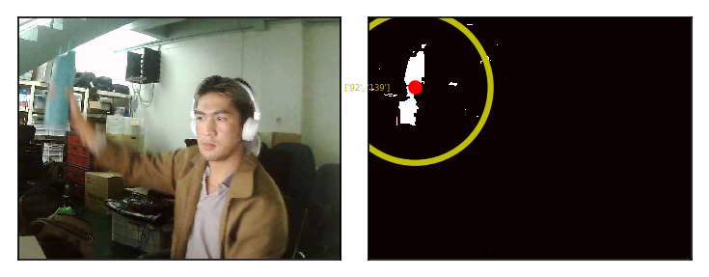
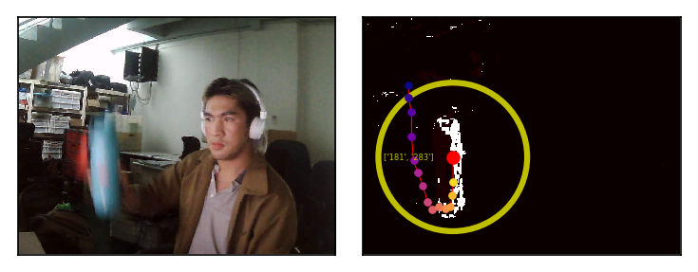
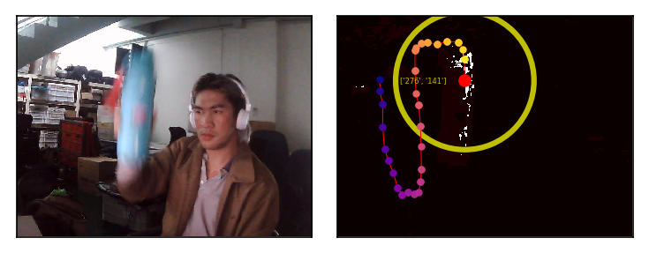
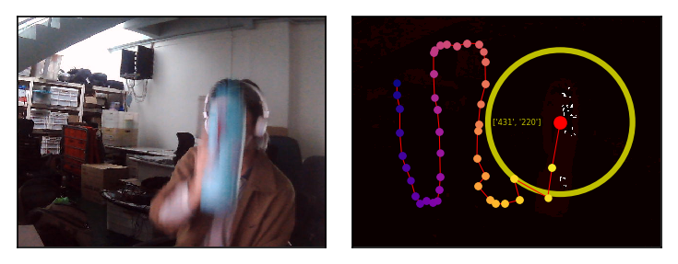
Tracking
From the webcam live feed, we first took 100 frames, segmented each image, and then stored the centroid coordinates. Shown below are some snapshots at different time frames while I move the object sinusoidally.
FRAME 1 FRAME 25 .
FRAME 50 FRAME 75 .

Slide 10
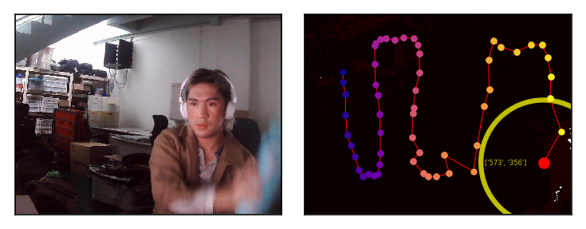
Discussion
In summary, we were able to acquire live images from webcam and applied color segmentation to track objects. Fundamental problems include (1) built-in auto white-balancing in the webcam used which continuously change the colors in the scene and (2) low resolution/frame rate which results to poor capture of the motion. The effects are evident on the latter half of the tracking where the segmentation evidently struggles, consequently affecting the centroid detection and thus, the tracking.
View GIF here: https://giphy.com/gifs/python-tracking-video-processing-hJO3Sw9Hq0HOsO60TX/fullscreen

Slide 11
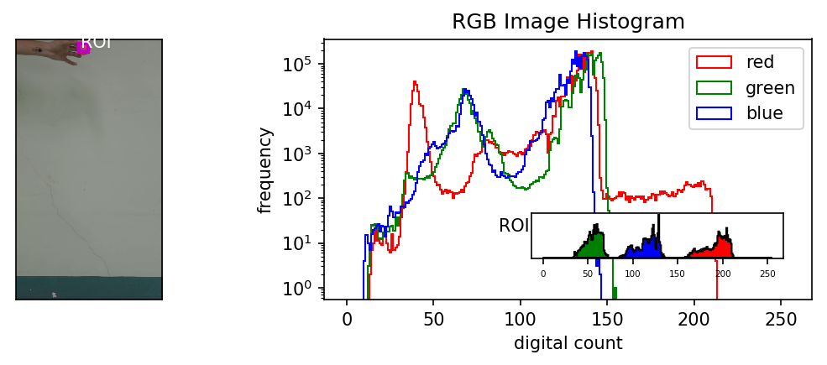
Applications
Since we’ve been limited by the resolution, framerate, and auto white-balancing of a webcam, here we try to apply tracking on a video recorded using a digital camera. To demonstrate a sample practical application, which I also did in my App Physics 186 class, we attempt to track free fall motion and experimentally determine the acceleration due to gravity [5]. The video used is at 60 frames-per-second, color-consistent, and has a high resolution. Shown below is a snapshot of the first image frame and the comparison of its histogram vs the ROI’s (pink rubber ball).

Slide 12
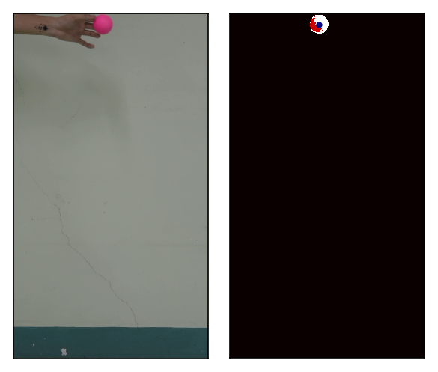
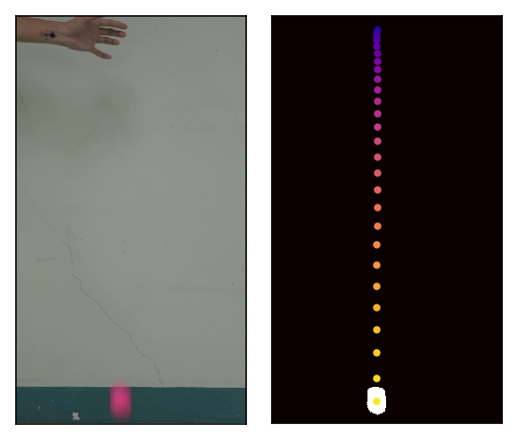
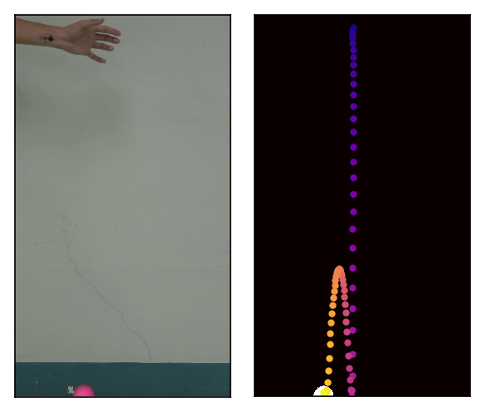
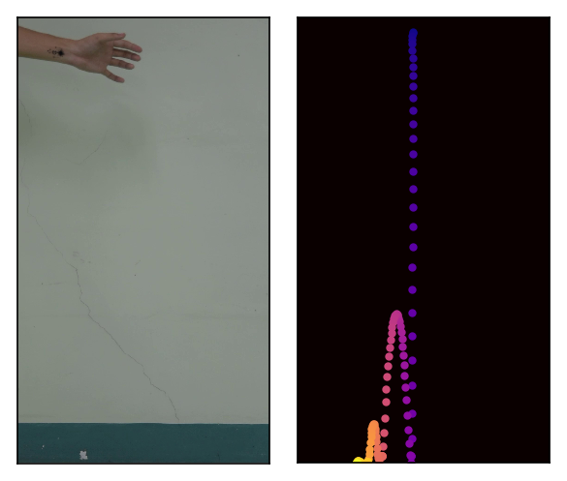
Free Fall
Overall, the segmentation and centroid detection went smooth, not to mention that there were no artifacts since we have a uniform background.
Using the pixel-to-meter ratio obtained by relating the balls diameter in pixels and in meters, we were able to convert pixel trajectory into actual height values. To extract g_{exp}, we take the first and second derivative of the trajectory which represents the velocity and acceleration functions of the free-falling body, respectively. As shown in the plots (next page), we got g_{exp} = -9.79 m/s², which deviates by 0.2% from the theoretical value.
In conclusion, we were able to successfully perform a kinematics experiment through video processing.
View GIF here: https://giphy.com/gifs/python-tracking-opencv-D4xFw0VusmBMC0UlKf/fullscreen

Slide 13
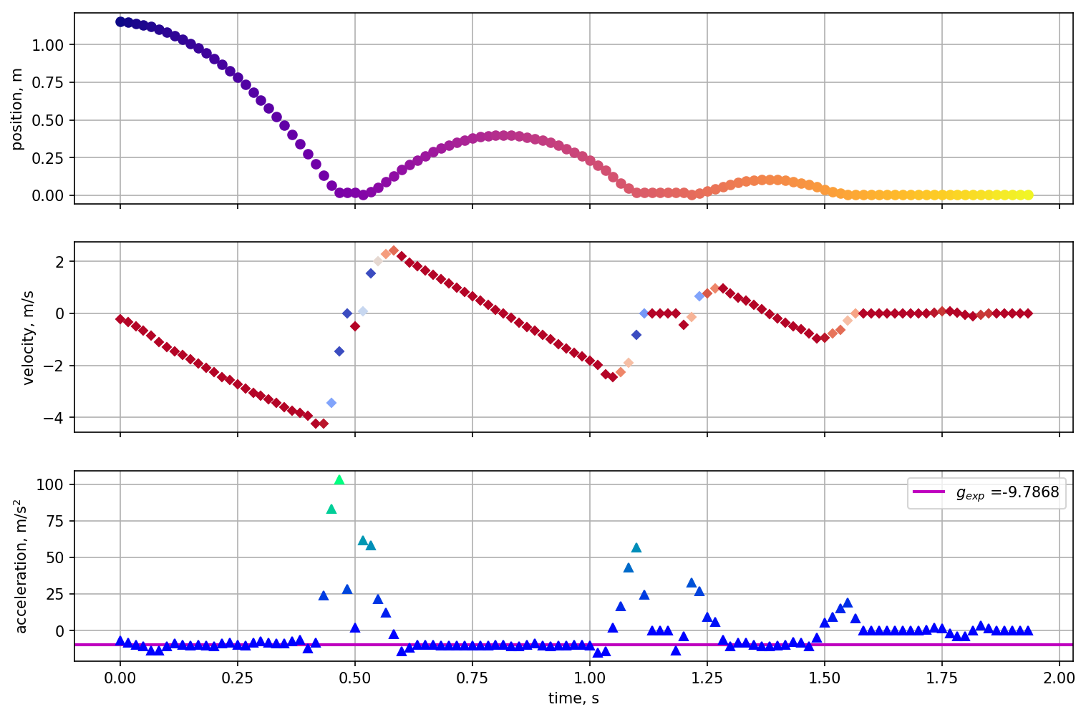
Kinematic Graphs

Slide 14
reflection
As mentioned previously, I have used PCA before in spectral resolution but in this report, I was able to compare how the method fared across all different light sources. The visualizations were stand-alone and self-explanatory. One important finding is that it turns out, the skewed power distribution contributed to rendering spectra with large color difference. The take-away here is the same as what my undergraduate thesis proposed; we should implement both spectral and color error metrics to evaluate the spectral reconstruction.
In this activity, I’d give myself a score of 100/100.
[1] OpenCV: Getting Started with Videos
[2] M. Soriano, Applied Physics 186 - Image Segmentation, (2019).
[3] M. Soriano, Physics 301 - Color Segmentation, (2022).
[4] Find Center of a Blob (Centroid) Using OpenCV (C++/Python) | LearnOpenCV
[5] Basic Video Processing (rlprincipe.wixsite.com)

